Slide 1
Multithreading in Java
UNIT ii

Slide 2
Contents
Thread Model
Main Thread
Creating single and multiple threads
Thread Priorities
Synchronization
Inter-thread Communication
Suspending, Resuming and Stopping threads
Using Multithreading

Slide 3
Introduction
Multithreaded Programming:
A multithreaded program contains two or more parts that can run concurrently.
Thread:
Each part of multithreaded program is called a thread
Each thread defines a separate path of execution.
Multithreading is a specialized form of multitasking; 2 types:
Process-Based – Many programs runs in parallel
Thread-Based – A single program runs two or more task in parallel

Slide 4
Advantages of multithreading:
Write very efficient programs that make maximum use of the CPU; as CPU idle time is minimum
Used in interactive, networked environment
“Event loop with Polling” Approach:
An approach used by single-threaded model
Single thread of control runs in an infinite loop, polling a single event queue to decide what to do next
Until the first event in the queue is completed, other events will be in the queue, even if CPU is idle.
If that event is waiting for a resource, other events are blocked.

Slide 5
1. Java Thread Model
In Java thread model - main loop/polling mechanism is eliminated
One thread can pause without stopping other parts of the program
Hence when CPU is idle, other event in the queue will be processed. Hence improving efficiency of CPU

Slide 6
States of a Thread (5 States)
Running – Active in CPU
Ready to run – Ready and waiting for CPU
Suspended – A thread temporarily suspends its activity
Resumed – A suspended thread to resumed to continue from where it left off.
Blocked – A thread can be blocked when waiting for a resource

Slide 7
Thread Priority
Java assigns to each thread a priority.
Priority determines how that thread should be treated with respect to the others
Thread priorities are integers
Priorities does not mean how fast the thread executes, rather it is used to decide when to switch from one running thread to the next – Context Switching

Slide 8
2 Rules During Context Switch
A thread can voluntarily relinquish control
This is done by explicitly yielding, sleeping, or blocking on pending I/O.
Here, all waiting threads in queue are examined, and the highest-priority thread that is ready to run is given the CPU
A thread can be preempted by a higher-priority thread
A lower-priority thread, that does not yield the processor is simply preempted by a higher-priority thread.
Basically, as soon as a higher-priority thread wants to run, it does.
This is called preemptive multitasking

Slide 9
Synchronization
There should not be any conflict between two threads that access the common data (data structure)
That is, you must prevent one thread from writing data while another thread is in the middle of reading it
Solution: “Monitor”
Monitor is a very small box that can hold only one thread.
Once a thread enters a monitor, all other threads must wait until that thread exits the monitor

Slide 10
Messaging
A way through which threads communicate with each other
Also, it allows a thread to enter a synchronized method on an object, and then wait there until some other thread explicitly notifies it to come out

Slide 11
The Thread Class and the Runnable Interface
Java’s multithreading system is built upon the Thread class
All its methods are from Runnable interface
To create a new thread, your program will either extend Thread or implement the Runnable interface

Slide 12
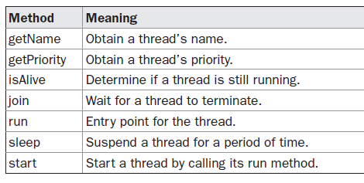
The Thread class defines several methods that help manage threads

Slide 13
2. The Main Thread
When a Java program starts up,
one thread begins running immediately = main thread
Main thread is important for two reasons:
It is the thread from which other “child” threads will be spawned.
Often, it must be the last thread to finish execution because it performs various shutdown actions

Slide 14
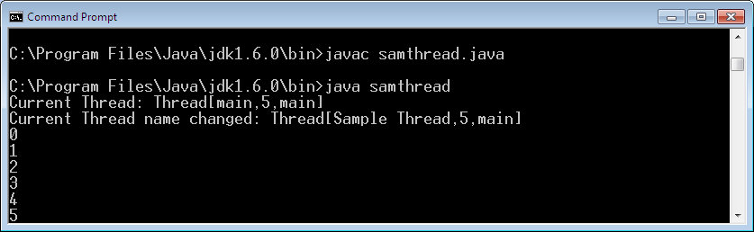
class samthread
{
public static void main(String args[]) throws Exception
{
Thread t = Thread.currentThread();
System.out.println("Current Thread: "+t);
t.setName("Sample Thread");
System.out.println("Current Thread name changed: "+t);
for(int i=0;i<10;i++)
{ System.out.println(i);
Thread.sleep(1000);
}
} }

Slide 15
static Thread currentThread( )
Used to obtain a reference to a function,
by calling the method currentThread( ), which is a public static member of Thread
This method returns a reference to the thread in which it is called
final void setName(); final String getName();
Set/get the name of a thread
static void sleep(long milliseconds) throws InterruptedException
Time (in ms) to make the thread suspend

Slide 16
3. Creating a Thread
2 ways:
Implement the Runnable interface
Extend the Thread class
Implementing Runnable:
Create a class that implements “Runnable”
Should define a function “void run()” – define the code that is to be treated as Thread
The thread ends, when run() method is completed
Instantiate a method “Thread(Runnable obj, String Name)”

Slide 17
class NewThread implements Runnable {
Thread t;
NewThread()
{
t=new Thread (this, “Sample”);
t.start();
}
public void run()
{ … }
}
class sam
{
PSVM(String arg[])
{ new NewThread();
… }

Slide 18
Extending “Thread”:
Create a new class that extends Thread
The extending class must override the run( ) method – Run point of the Thread
Called using start()

Slide 19
class NewThread extends Thread {
NewThread()
{
super(“Demo Thread”);
start();
}
public void run()
{ … }
}
class sam
{
PSVM(String arg[])
{ new NewThread();
… }

Slide 20
Creating Multiple Threads
class NewThread implements Runnable {
Thread t;
String name;
NewThread(String n)
{
name=n;
t=new Thread (this, name);
t.start();
}
public void run()
{ … }
}
class sam
{
PSVM(String arg[])
{
new NewThread(“one”);
new NewThread(“two”);
new NewThread(“three”);
…
}
}

Slide 21
Using isAlive() and join()
If main() thread is required to be completed at last, make it sleep using sleep() function – Tough to imagine when other threads will be completed.
Hence use:
final boolean isAlive() → returns true if the thread upon which it is called is still running
final void join() → This method waits until the thread on which it is called terminates

Slide 22
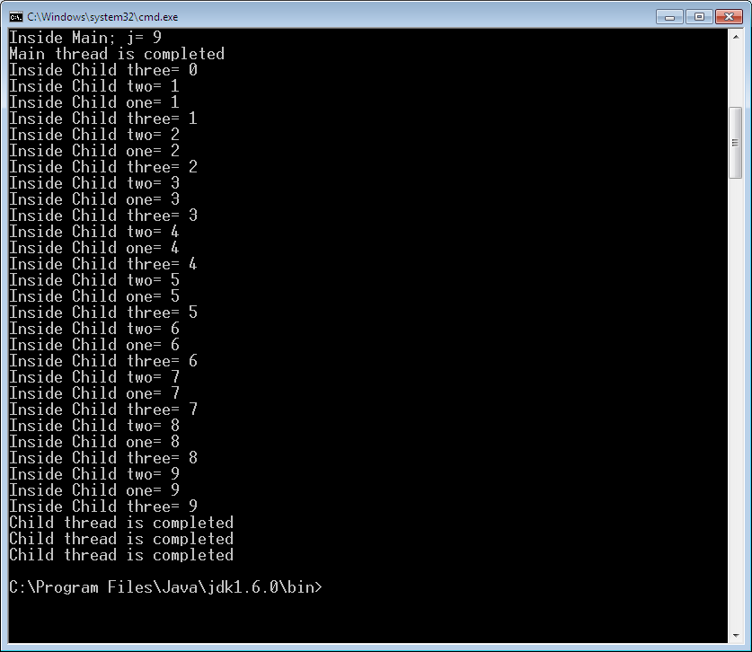

Slide 23
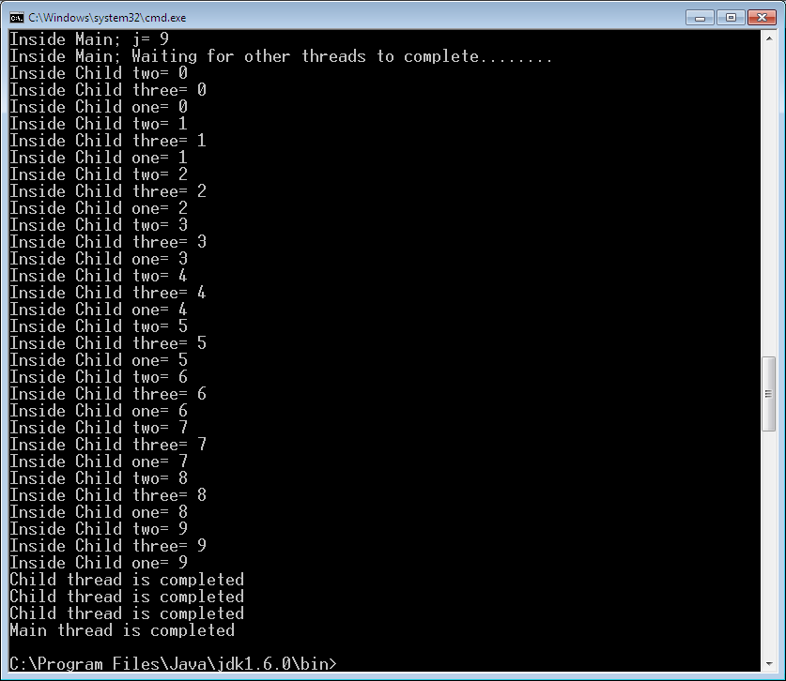

Slide 24
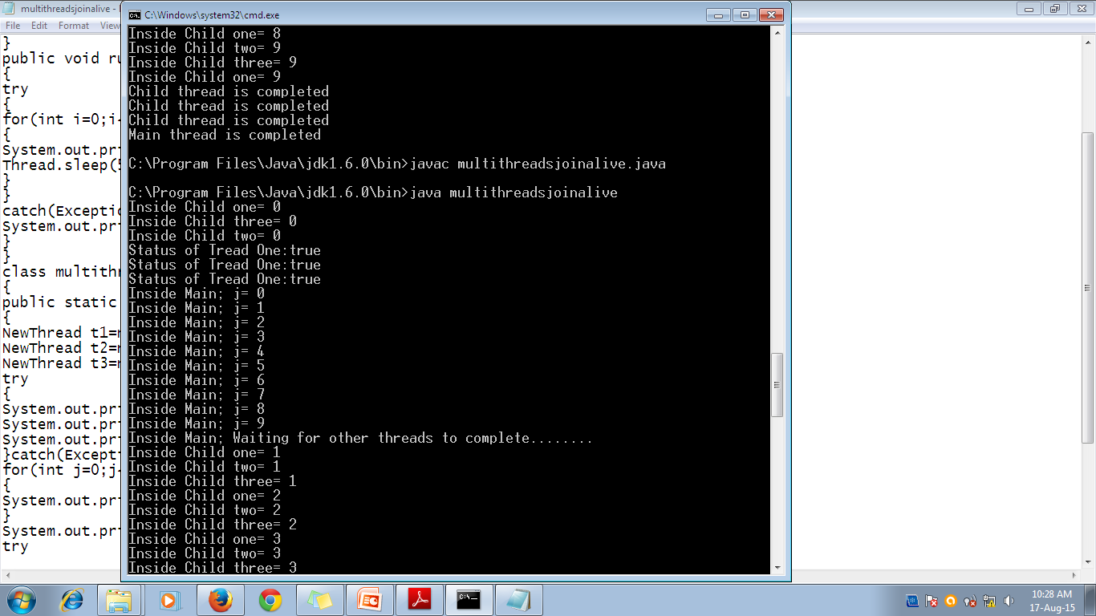


Slide 25
4. Thread Priority
Used by the thread scheduler to decide when each thread should be allowed to run
Higher-priority threads get more CPU time than lower-priority threads
A higher-priority thread can also preempt a lower-priority one

Slide 26
To set a thread’s priority:
final void setPriority(int level)
Level →b/w MIN_PRIORITY(1) - MAX_PRIORITY (10)
NORM_PRIORITY → to bring a thread to normal default priority = 5
To get a thread’s priority:
final int getPriority( )

Slide 27
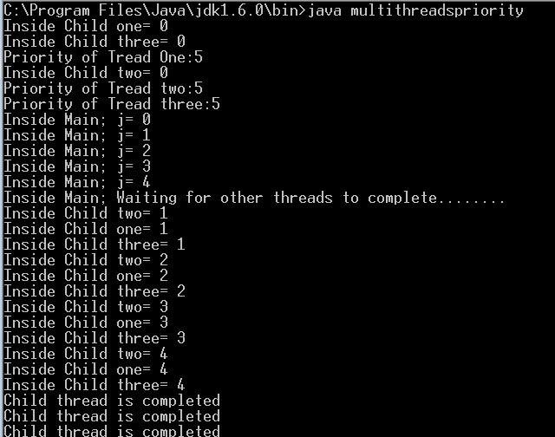

Slide 28
5. Synchronization
Used to achieve the property that:
Two or more threads will not access the shared resource at the same time.
Achieved through “Monitor” (also called semaphore)
A monitor is an object that is used as a mutually exclusive lock, or mutex
Only one thread can own a monitor at a given time.
When a thread acquires a lock, it is said to have entered the monitor.
All other threads attempting to enter the locked monitor will be suspended until the first thread exits the monitor.
These other threads are said to be waiting for the monitor

Slide 29
Race Condition:
A condition where threads are racing each other to complete the method.
2 ways to achieve synchronization in Java:
Using “Synchronized” Methods
Using “Synchronized” statements
a) Using “Synchronized” Methods
To enter into a “monitor”, just call a method that has been modified with the synchronized keyword.
Provides serialized access to a method
While a thread is inside a synchronized method, all other threads that try to call it have to wait

Slide 30
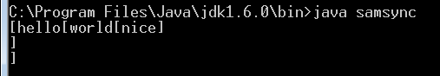
class samthread implements Runnable
{
Thread t;
String name, word;
sam s;
samthread(sam ss, String w)
{
s=ss;
word=w;
t=new Thread(this, “demo”);
t.start();
}
public void run()
{
s.disp(word);
}
}
class sam
{
void disp(String word)
{
System.out.print("["+word);
try
{
Thread.sleep(1000); } catch(Exception e) { }
System.out.print("]\n");
}
}
class samsync
{
public static void main(String args[]) throws Exception {
sam s1=new sam();
new samthread(s1, "hello");
new samthread(s1, "world");
new samthread(s1, “nice");
} }

Slide 31
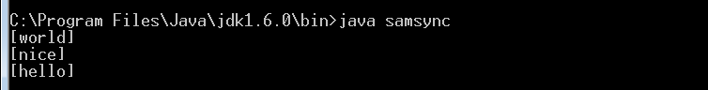
class samthread implements Runnable
{
Thread t;
String name, word;
sam s;
samthread(sam ss, String w)
{
s=ss;
word=w;
t=new Thread(this, “demo”);
t.start();
}
public void run()
{
s.disp(word);
}
}
class sam
{
synchronized void disp(String word)
{
System.out.print("["+word);
try
{
Thread.sleep(1000); } catch(Exception e) { }
System.out.print("]\n");
}
}
class samsync
{
public static void main(String args[]) throws Exception {
sam s1=new sam();
new samthread(s1, "hello");
new samthread(s1, "world");
new samthread(s1, “nice");
} }

Slide 32
b) Using “Synchronized” statement
“Synchronized” keyword can be given only for those methods whose source code is available.
If a class/method is not created by you – cannot be added with “synchronized” keyword
Hence use “Synchronized” statement
Syntax: synchronized(object) {
// statements to be synchronized
}

Slide 33
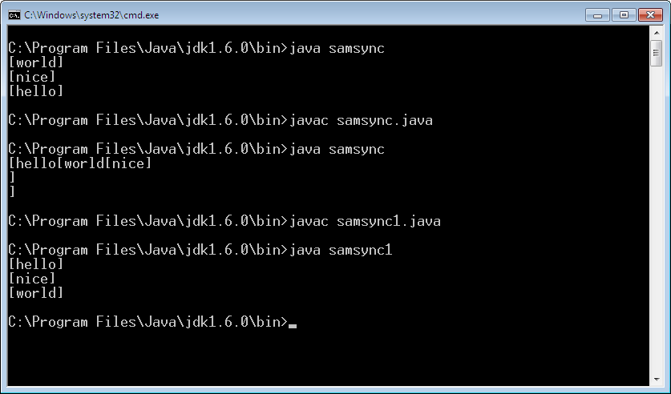
class samthread implements Runnable
{
Thread t;
String name, word;
sam s;
samthread(sam ss, String w)
{
s=ss;
word=w;
t=new Thread(this, “demo”);
t.start();
}
public void run()
{
synchronized(s) {
s.disp(word); }
}
}
class sam
{
void disp(String word)
{
System.out.print("["+word);
try
{
Thread.sleep(1000); } catch(Exception e) { }
System.out.print("]\n");
}
}
class samsync
{
public static void main(String args[]) throws Exception {
sam s1=new sam();
new samthread(s1, "hello");
new samthread(s1, "world");
new samthread(s1, “nice");
} }

Slide 34
6. Inter-thread Communication
Used to avoid “polling” – that wastes CPU time
3 methods are used in inter-thread communication
wait( )
notify( )
notifyAll( )
These methods are called only within the synchronized block/ method

Slide 35
wait()
Tells the calling thread to give up the monitor and go to sleep until some other thread enters the same monitor and calls notify( )
notify( )
Wakes up a thread that called wait( ) on the same object.
notifyAll( )
Wakes up all the threads that called wait( ) on the same object.
One of the threads will be granted access.
Spurious wakeup: A condition where, a thread which is in waiting state is waked up without notify() or notifyAll() methods
Hence, wait() should check the status of other thread before notify()

Slide 36
Producer and Consumer Problem
Refer program

Slide 37
Deadlock
A special type of error that is to be avoided
Deadlock:
A situation that occurs when two threads have a circular dependency on a pair of synchronized objects.
Thread A
Thread B
Monitor A
Stores x;
Read y;
Monitor B
Stores y;
Read x;

Slide 38
Suspending, Resuming and Stopping Threads
final void suspend()
To temporarily stop the thread
final void resume()
To resume a suspended thread
final void stop()
Killing the thread. Cannot be restarted using resume()

